Slide 1
Data Warehouse

Slide 2
A data warehouse is a subject-oriented, integrated, time-variant, and nonvolatile collection of data in support of management’s decision-making process.”—W. H. Inmon
Data warehousing:
  The process of constructing and using data warehouses

Slide 3
Data Warehouse—Subject-Oriented
Organized around major subjects, such as customer, product, sales rather than day to day operations and transactions
Focusing on the modeling and analysis of data for decision makers, not on daily operations or transaction processing
Provide a simple and concise view around particular subject issues by excluding data that are not useful in the decision support process

Slide 4
Data Warehouse—Integrated
Constructed by integrating multiple, heterogeneous data sources
  relational databases, flat files, on-line transaction records
Data cleaning and data integration techniques are applied.
  Ensure consistency in naming conventions, encoding structures, attribute measures, etc. among different data sources
    E.g., Hotel price: currency, tax, breakfast covered, etc.
  When data is moved to the warehouse, it is converted.

Slide 5
Data Warehouse—Time Variant
The time horizon for the data warehouse is significantly longer than that of operational systems
  Operational database: current value data
  Data warehouse data: provide information from a historical perspective (e.g., past 5-10 years)
Every key structure in the data warehouse
  Contains an element of time, explicitly or implicitly
  But the key of operational data may or may not contain “time element”

Slide 6
Data Warehouse—Nonvolatile
A physically separate store of data transformed from the operational environment
Operational update of data does not occur in the data warehouse environment
  Does not require transaction processing, recovery, and concurrency control mechanisms
  Requires only two operations in data accessing:
    initial loading of data and access of data

Slide 7
Data Warehouse vs. Heterogeneous DBMS
Traditional heterogeneous DB integration: A query driven approach
  Build wrappers/mediators on top of heterogeneous databases
  When a query is posed to a client site, a meta-dictionary is used to translate the query into queries appropriate for individual heterogeneous sites involved, and the results are integrated into a global answer set
  Complex information filtering, compete for resources
Data warehouse: update-driven, high performance
  Information from heterogeneous sources is integrated in advance and stored in warehouses for direct query and analysis

Slide 8
Data Warehouse vs. Operational DBMS
OLTP (on-line transaction processing)
  Major task of traditional relational DBMS
  Day-to-day operations: purchasing, inventory, banking, manufacturing, payroll, registration, accounting, etc.
OLAP (on-line analytical processing)
  Major task of data warehouse system
  Data analysis and decision making
Distinct features (OLTP vs. OLAP):
  User and system orientation: customer vs. market
  Data contents: current, detailed vs. historical, consolidated
  Database design: ER + application vs. star + subject
  View: current, local vs. evolutionary, integrated
  Access patterns: update vs. read-only but complex queries

Slide 9
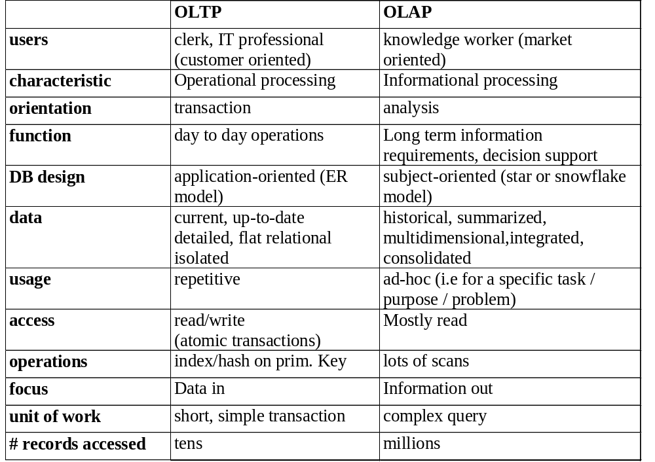
OLTP vs. OLAP

Slide 10
Why Separate Data Warehouse?
High performance for both systems
  DBMS— tuned for OLTP: access methods, indexing, concurrency control, recovery
  Warehouse—tuned for OLAP: complex OLAP queries, multidimensional view, consolidation
Different functions and different data:
  missing data: Decision support requires historical data which operational DBs do not typically maintain
  data consolidation: DS requires consolidation (aggregation, summarization) of data from heterogeneous sources
  data quality: different sources typically use inconsistent data representations, codes and formats which have to be reconciled
Note: There are more and more systems which perform OLAP analysis directly on relational databases

Slide 11
From Tables and Spreadsheets to Data Cubes
A data warehouse is based on a multidimensional data model which views data in the form of a data cube
A data cube, such as sales, allows data to be modeled and viewed in multiple dimensions
  Dimension tables, such as item (item_name, brand, type), or time(day, week, month, quarter, year) describes the dimension.
  Fact table contains the names of the facts or measures (such as dollars_sold) and keys to each of the related dimension tables (facts are numerical measures)

Slide 12
We may display any n-D data as a series of (n-1)-D “cubes”.
In data warehousing literature,
  Lowest level of summarization an n-D base cube is called a base cuboid.(eg: 4-D cuboid)
  The top most 0-D cuboid, which holds the highest-level of summarization, is called the apex cuboid.
  The lattice of cuboids forms a data cube which give a different degree of summarization

Slide 13
Cube: A Lattice of Cuboids
all
0-D(apex) cuboid
time
item
location
supplier
1-D cuboids
time,location
item,location
location,supplier
time,item
2-D cuboids
time,supplier
item,supplier
time,location,supplier
3-D cuboids
time,item,location
time,item,supplier
item,location,supplier
4-D(base) cuboid
time, item, location, supplier

Slide 14
Conceptual Modeling of Data Warehouses
ER model designed for relational databases. It is appropriate for OLTP.
A data warehouse requires a concise, subject oriented schema that facilities on-line data analysis.
Most popular data model for a data warehouse is a multidimensional model.

Slide 15
Modeling data warehouses: dimensions & measures
  Star schema: A fact table in the middle connected to a set of dimension tables
  Snowflake schema: A refinement of star schema where some dimensional hierarchy is normalized into a set of smaller dimension tables, forming a shape similar to snowflake
  Fact constellations: Multiple fact tables share dimension tables, viewed as a collection of stars, therefore called galaxy schema or fact constellation

Slide 16
Example of Star Schema
time
time_key
day
day_of_the_week
month
quarter
year
item
item_key
item_name
brand
type
supplier_type
Sales Fact Table
time_key
item_key
branch_key
branch
location
location_key
branch_key
branch_name
branch_type
location_key
street
city
state_or_province
country
units_sold
dollars_sold
avg_sales
Measures

Slide 17
Example of Snowflake Schema
time
item
time_key
day
day_of_the_week
month
quarter
year
item_key
item_name
brand
type
supplier_key
supplier
Sales Fact Table
supplier_key
supplier_type
time_key
item_key
branch_key
branch
location
location_key
location_key
street
city_key
branch_key
branch_name
branch_type
units_sold
dollars_sold
city
city_key
city
state_or_province
country
avg_sales
Measures

Slide 18
Example of Fact Constellation
time
time_key
day
day_of_the_week
month
quarter
year
item
Shipping Fact Table
item_key
item_name
brand
type
supplier_type
Sales Fact Table
time_key
time_key
item_key
shipper_key
item_key
branch_key
from_location
branch
location_key
location
to_location
branch_key
branch_name
branch_type
units_sold
location_key
street
city
province_or_state
country
dollars_cost
dollars_sold
units_shipped
avg_sales
shipper
Measures
shipper_key
shipper_name
location_key
shipper_type

Slide 19
Measures of Data Cube: Three Categories
Distributive: if the result derived by applying the function to n aggregate values is the same as that derived by applying the function on all the data without partitioning
    E.g., count(), sum(), min(), max()
Algebraic: if it can be computed by an algebraic function with M arguments (where M is a bounded integer), each of which is obtained by applying a distributive aggregate function
    E.g., avg(), min_N(), standard_deviation()
Holistic: if there is no constant bound on the storage size needed to describe a subaggregate.
    E.g., median(), mode(), rank()

Slide 20
A Concept Hierarchy: Dimension (location)
all
all
region
Europe
...
North_America
country
Germany
...
Spain
Canada
...
Mexico
city
Frankfurt
...
Vancouver
...
Toronto
office
L. Chan
...
M. Wind

Slide 21

A Sample Data Cube
Date
Total annual sales
of TV in U.S.A.
1Qtr
2Qtr
3Qtr
4Qtr
sum
Product
TV
PC
U.S.A
VCR
sum
Canada
Country
Mexico
sum
All, All, All

Slide 22
Cuboids Corresponding to the Cube
all
0-D(apex) cuboid
product
date
country
1-D cuboids
product,date
product,country
date, country
2-D cuboids
3-D(base) cuboid
product, date, country

Slide 23

Browsing a Data Cube
Visualization
OLAP capabilities
Interactive manipulation

Slide 24
Typical OLAP Operations
Roll up (drill-up): summarize data
  by climbing up hierarchy or by dimension reduction
Drill down (roll down): reverse of roll-up
  from higher level summary to lower level summary or detailed data, or introducing new dimensions
Slice and dice: project and select
Pivot (rotate):
  reorient the cube, visualization, 3D to series of 2D planes
Other operations
  drill across: involving (across) more than one fact table
  drill through: through the bottom level of the cube to its back-end relational tables (using SQL)

Slide 25
Data Warehouse Architecture

Slide 26
What can business analysts gain from having a data warehouse?
Competitive advantage
Productivity
Customer relationship management
Cost reduction

Slide 27
Design of Data Warehouse: A Business Analysis Framework
Four views regarding the design of a data warehouse
  Top-down view
    allows selection of the relevant information necessary for the data warehouse
  Data source view
    exposes the information being captured, stored, and managed by operational systems
  Data warehouse view
    consists of fact tables and dimension tables
  Business query view
    sees the perspectives of data in the warehouse from the view of end-user

Slide 28
Data Warehouse Design Process
Data warehouse can be built using a Top-down approach, bottom-up approache or a combination of both
  Top-down: Starts with overall design and planning (mature)
  Bottom-up: Starts with experiments and prototypes (rapid)
From software engineering point of view
  Waterfall: structured and systematic analysis at each step before proceeding to the next
  Spiral: rapid generation of increasingly functional systems, short turn around time, quick turn around

Slide 29
Typical data warehouse design process
  Choose a business process to model, e.g., orders, invoices, etc. (data warehouse; data mart)
  Choose the grain (atomic level of data) of the business process
  Choose the dimensions that will apply to each fact table record
  Choose the measure that will populate each fact table record

Slide 30
Data Warehouse: A Multi-Tiered Architecture
Monitor
&
Integrator
OLAP Server
Other
sources
Metadata
Analysis
Query
Reports
Data mining
Operational
DBs
Extract
Transform
Load
Refresh
Data
Warehouse
output
Data Marts
Data Sources
Bottom tier :Data
Warehouse Server
Middle tier : OLAP Server
Top tier :
Front-End Tools

Slide 31
Three Data Warehouse Models
Enterprise warehouse
  collects all of the information about subjects spanning the entire organization
Data Mart
  a subset of corporate-wide data that is of value to a specific groups of users. Its scope is confined to specific, selected groups, such as marketing data mart
    Independent vs. dependent (directly from warehouse) data mart
Virtual warehouse
  A set of views over operational databases
  Only some of the possible summary views may be materialized

Slide 32
Data Warehouse Back-End Tools and Utilities
Data extraction
  get data from multiple, heterogeneous, and external sources
Data cleaning
  detect errors in the data and rectify them when possible
Data transformation
  convert data from legacy or host format to warehouse format
Load
  sort, summarize, consolidate, compute views, check integrity, and build indicies and partitions
Refresh
  propagate the updates from the data sources to the warehouse

Slide 33
Metadata Repository
Meta data is data about data.
Meta data is the data defining warehouse objects.
Metadata Repository should contain(it stores):
  Description of the structure of the data warehouse
    schema, view, dimensions, hierarchies, derived data defn, data mart locations and contents
  Operational meta-data
    data lineage (history of migrated data and transformation path), currency of data (active, archived, or purged), monitoring information (warehouse usage statistics, error reports, audit trails)
  The algorithms used for summarization
  The mapping from operational environment to the data warehouse
  Data related to system performance
    warehouse schema, view and derived data definitions
  Business data
    business terms and definitions, ownership of data, charging policies

Slide 34
OLAP Server Architectures
Relational OLAP (ROLAP)
  Use relational or extended-relational DBMS to store and manage warehouse data and OLAP middle ware
  Include optimization of DBMS backend, implementation of aggregation navigation logic, and additional tools and services
  Greater scalability
Multidimensional OLAP (MOLAP)
  Sparse array-based multidimensional storage engine
  Fast indexing to pre-computed summarized data
Hybrid OLAP (HOLAP) (e.g., Microsoft SQLServer)
  Flexibility, e.g., low level: relational, high-level: array
Specialized SQL servers (e.g., Redbricks)
  Specialized support for SQL queries over star/snowflake schemas

Slide 35

Efficient Data Cube Computation
Data cube can be viewed as a lattice of cuboids
  The bottom-most cuboid is the base cuboid
  The top-most cuboid (apex) contains only one cell
  Total number of cuboids for n-dimensional data cube is 2^{n}
  How many cuboids in an n-dimensional cube with L levels?
Materialization of data cube
  Materialize every (cuboid) (full materialization), none (no materialization), or some (partial materialization)
  Selection of which cuboids to materialize
    Based on size, sharing, access frequency, etc.

Slide 36
Materialization of data cube
3 choices of materialization
  No materialization
    do no precompute any of the “nonbase” cuboids.
    Extremely slow.
  Full materialization
    precompute all of the cuboids.
    Referred as Full cube.
    Requires large memory space.
  Partial materialization
    selectively compute a proper subset of the whole set of possible cuboids.
    Better response time and lesser memory space.

Slide 37

Iceberg Cube
Computing only the cuboid cells whose count or other aggregates satisfying the condition like
      HAVING COUNT(*) >= minsup
Motivation
  Only a small portion of cube cells may be “above the water’’ in a sparse cube
  Only calculate “interesting” cells—data above certain threshold
  Avoid explosive growth of the cube
    Suppose 100 dimensions, only 1 base cell. How many aggregate cells if count >= 1? What about count >= 2?

Slide 38
Iceberg Cube, Closed Cube & Cube Shell
Is iceberg cube good enough?
  2 base cells: {(a₁, a₂, a₃ . . . , a₁₀₀):10, (a₁, a₂, b₃, . . . , b₁₀₀):10}
  How many cells will the iceberg cube have if having count(*) >= 10? Hint: A huge but tricky number!
Close cube:
  Closed cell c: if there exists no cell d, s.t. d is a descendant of c, and d has the same measure value as c.
  Closed cube: a cube consisting of only closed cells
  What is the closed cube of the above base cuboid? Hint: only 3 cells
Cube Shell
  Precompute only the cuboids involving a small # of dimensions, e.g., 3
  More dimension combinations will need to be computed on the fly
For (A₁, A₂, … A₁₀), how many combinations to compute?
Notes:
If the two base cells were: {(a₁, a₂, a₃ . . . , a₁₀₀):10, (b₁, b₂, b₃, . . . , b₁₀₀):10}, the total # of non-base cells should be 2 * 2^{100} – 3.
But for {(a₁, a₂, a₃ . . . , a₁₀₀):10, (a₁, a₂, b₃, . . . , b₁₀₀):10}, the total # of non-base cells should be 2 * 2^{100} – 6.

Slide 39
Data Warehouse Usage
Three kinds of data warehouse applications
  Information processing
    supports querying, basic statistical analysis, and reporting using crosstabs, tables, charts and graphs
  Analytical processing
    multidimensional analysis of data warehouse data
    supports basic OLAP operations, slice-dice, drilling, pivoting
  Data mining
    knowledge discovery from hidden patterns
    supports associations, constructing analytical models, performing classification and prediction, and presenting the mining results using visualization tools

Slide 40
From On-Line Analytical Processing (OLAP) to On Line Analytical Mining (OLAM)
Why online analytical mining?
  High quality of data in data warehouses
    DW contains integrated, consistent, cleaned data
  Available information processing structure surrounding data warehouses
    ODBC, OLEDB, Web accessing, service facilities, reporting and OLAP tools
  OLAP-based exploratory data analysis
    Mining with drilling, dicing, pivoting, etc.
  On-line selection of data mining functions
    Integration and swapping of multiple mining functions, algorithms, and tasks

Slide 41
An OLAM System Architecture
Mining result
Layer4
User Interface
Mining query
User GUI API
OLAM
Engine
OLAP
Engine
Layer3
OLAP/OLAM
Data Cube API
Layer2
MDDB
MDDB
Meta Data
Database API
Layer1
Data Repository
Filtering&Integration
Filtering
Data cleaning
Data
Warehouse
Databases
Data integration

Slide 42
Summary: Data Warehouse and OLAP Technology
Why data warehousing?
A multi-dimensional model of a data warehouse
  Star schema, snowflake schema, fact constellations
  A data cube consists of dimensions & measures
OLAP operations: drilling, rolling, slicing, dicing and pivoting
Data warehouse architecture
OLAP servers: ROLAP, MOLAP, HOLAP
Efficient computation of data cubes
  Partial vs. full vs. no materialization
  Indexing OALP data: Bitmap index and join index
  OLAP query processing
From OLAP to OLAM (on-line analytical mining)

